Slide 1
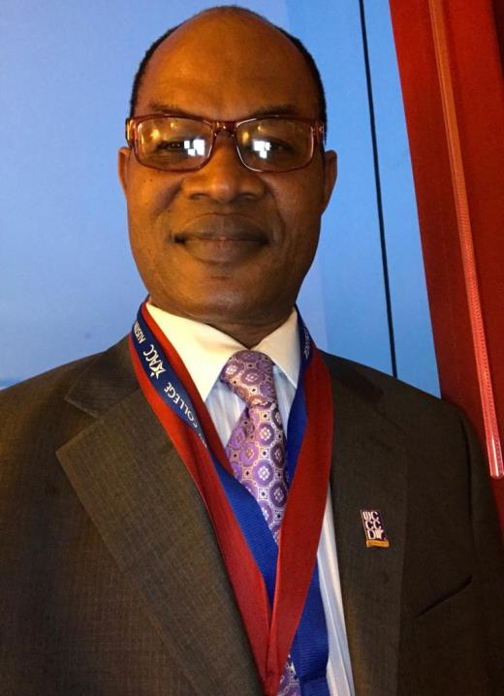
Dr Christian Nwamba, your AFT2000’s current president for the past 2 years, is seeking for your support and re-election vote to continue serving the union as the He has successfully served us well in the past 2 years. He is well trained as your union leader and advocate. He is well experienced to lead as your spokes person. He is a problem solver who will fight for your rights. He is a team player with tenacity to unite members. A union builder, mentor, advocate and friend to many. He is an astute member representative and negotiator. Vote for him to join hands in fighting for, and building a stronger, friendly union that fights for, represents and stands for all members.
President for AFT 2000

